Slide 1
Low birth weight and anemia in family involvement antenatal care: Health Promoting Hospital Birth Statistics 2013 Review
Suraphan Sangsawang
Atchara Varophas
Suthisak Konkaew
Ratchaneewan Charuloedphong
Notes:
Health Promoting Hospital of Health Center Region 10 has encouraged family to take part in the antenatal care (ANC) process; consisting of couple counseling, school for parents, and parturient & puerperium-attending-care practice of husband.
Anemia during pregnancy is common medical complication and carries the risk for preterm birth and LBW4.
We also have anemia during pregnancy as a common complication. But LBW of Health Promoting Hospital of Health Center Region 10 has still been less than 7%.

Slide 2
LBW goal < 7%
LBW Thailand2002: 8.8%, 2007: 8.7%
Notes:
LBW (Low birth weight means newborn-weight less than 2,500 grams at birth), one of the important indicators for maternal & child health, is aimed at less than 7% of live birth. But from the birth statistics of Thailand, LBW has long been the important health problem1 up until now. LBW statistics of Thailand; in the year 2008, 2009, 2010, 2011, 2012 were 8.8%, 8.6%, 8.1%, 8.2%, and 8.4%2,3, have never ever attained the goal.

Slide 3
8 Northern Provinces (Low birth Weight < 2,500 gms)
2011
Notes:
LBW statistics of Health Promoting Hospital of Health Center Region 10 were 6.87%, 6.80%, and 6.94% in the year 2011, 2012, and 2013. Even during these years, LBW statistics of the 8 Northern provinces were; 9.69%, 9.33%, and 9.15%, higher than LBW statistics of Thailand.

Slide 4
LBW and Anemia in Family Involvement ANC
Objective: To study the correlation of the family involvement in ANC process, anemia and LBW.
Methods: Health Promoting Hospital 1,527 live birth (including 7 twins and 8 maternal HIV/AIDS) statistics in the year 2013 (October 1, 2012-September 30, 2013) were reviewed. The numbers and percentages of the family-involvement cases in ANC process, anemia and LBW were analyzed by chi-square test. P-value less than 0.05 was statistically significant level.

Slide 5
Table1 : Data that were analyzed.
 | Number | percent
Number of live births | 1527
LBW | 106 | 6.94%
Family involvement in ANC | 338 | 22.13%
Anemia during pregnancy (first ANC or after 32 week GA) | 648 | 42.44%
Notes:
1,527 live births And 106 LBW-newborns, LBW per live births was 6.94%.
The LBW in family involvement during ANC was lower than the LBW in no-family involvement with statistical significance. The LBW in anemia at first ANC was higher than the LBW in no-anemia at first ANC with statistical significance. But the LBW in anemia after 32 week GA was not different from the LBW in no-anemia after 32 week GA.

Slide 6
Table2: Anemia and LBW
Anemia | LBW cases | LBW %
Anemia at first ANC 452 cases | 48 | 10.62
Anemia after 32 week GA 420 cases | 30 | 7.14
Total anemia 648 cases | 55 | 8.49

Slide 7
Table3: Family involvement and LBW
Family Involvement | LBW cases | LBW %
Complete Attending 338 cases | 12 | 3.55
No Attending 1,189 cases | 94 | 7.91
Total live birth 1,527 cases | 106 | 6.94

Slide 8
Table4: Family involvement, Anemia and LBW
Newborn 1527 cases | cases | LBW cases | % | P value
Family involvement | 338 | 12 | 3.55 | < 0.01
Anemia at first ANC | 452 | 48 | 10.62 | <0.0005
Anemia after 32 week | 420 | 30 | 7.14 | > 0.95
Notes:
The LBW in family involvement during ANC was lower than the LBW in no-family involvement with statistical significance. The LBW in anemia at first ANC was higher than the LBW in no-anemia at first ANC with statistical significance. But the LBW in anemia after 32 week GA was not different from the LBW in no-anemia after 32 week GA.

Slide 9
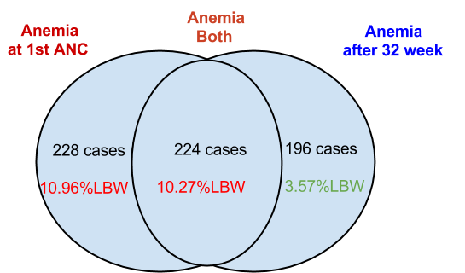
Diagram: Anemia and LBW

Slide 10
Anemia classified by family involvement and LBW outcome
 | Case | Family involve | LBW Cases | LBW % | Family No involve | LBW cases | LBW % | P value
Total Anemia | 648 | 125 | 7 | 5.60 | 523 | 42 | 8.03 | > 0.4
1st Anemia But normal after 32 wk | 228 | 29 | 1 | 3.45 | 199 | 24 | 12.06 | > 0.2
1st Anemia And Anemia after 32 wk. | 224 | 40 | 5 | 12.5 | 184 | 12 | 6.52 | > 0.9

Slide 11
Family involvement classified by anemia and LBW outcome
 | cases | Anemia cases | % | LBW cases | LBW % | No anemia cases | % | LBW cases | LBW % | p value
Family involve | 338 | 125 | 37 | 7 | 5.6 | 213 | 63 | 5 | 2.35 | > 0.1

Slide 13
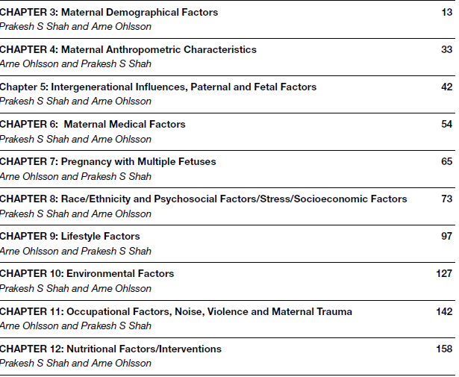

Slide 14
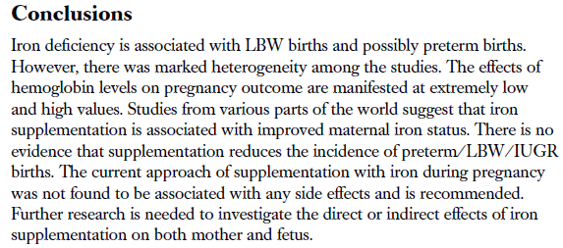
Iron, Anemia and LBW

Slide 15
High risk case & Education

Slide 16
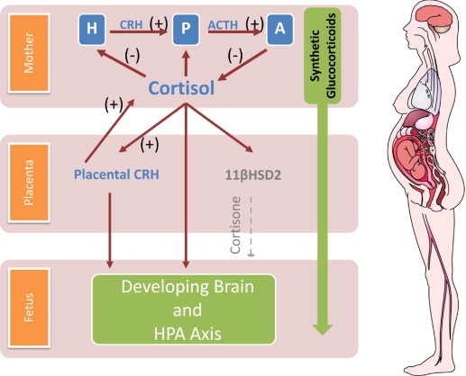

Slide 17
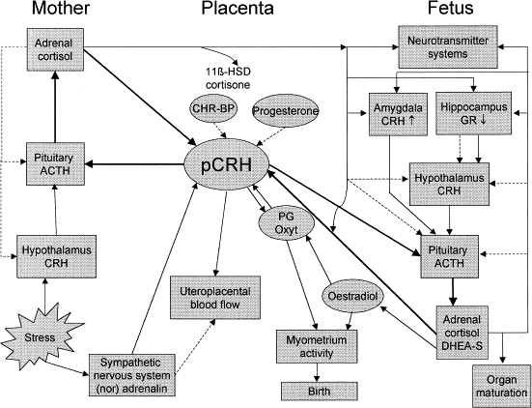

Slide 18
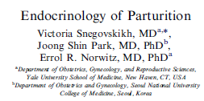

Slide 19
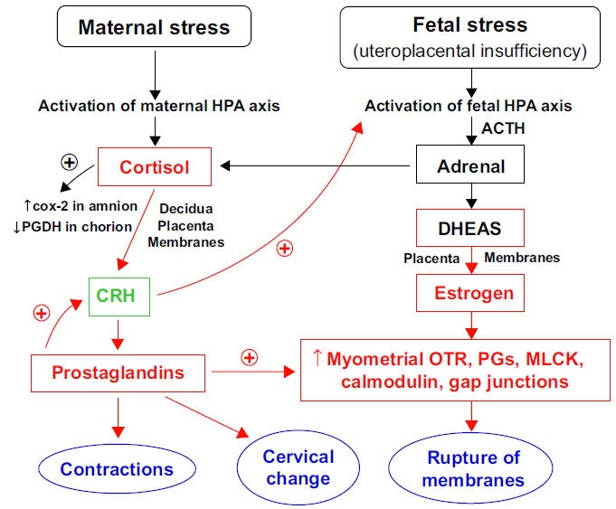

Slide 20
ความเครียด มีผลอย่างไรต่อร่างกาย
สมองส่วนไฮโปธาลามัส (เป็นตัวเชื่อมระหว่างการรับรู้ของระบบประสาทกับการตอบสนองของร่างกายผ่านการสร้างฮอร์โมนของระบบต่อมไร้ท่อ) เมื่อเกิดความเครียด
1.จะหลั่งฮอร์โมน (Corticotropin-Releasing Hormone, CRH) กระตุ้นฮอร์โมน (Adrenocorticotropic Hormone, ACTH) จากต่อมใต้สมอง ทำให้ต่อมหมวกไตหลั่งฮอร์โมนคอร์ติซอล (Cortisol) และ
2. กระตุ้นการหลั่งของนอร์เอพิเนฟริน (จาก Locus coeruleus) และ
3. ทำให้การหลั่งของซีโรโทนินจากแกนสมอง (Raphe nucleus of Pons) ผิดปกติ

Slide 21
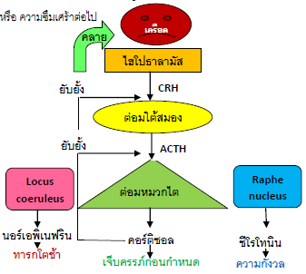

Slide 22
ผลของความเครียด
คอร์ติซอลจะทำให้น้ำตาลในเลือดสูงขึ้น และมีผลต่อไขมันกับโปรตีนของร่างกายให้เตรียมพร้อมต่อสู้หรือหลีกหนี (Fight or Flight) แต่กลับทำให้ระบบภูมิคุ้มกันของร่างกายต่อเชื้อโรคลดต่ำลง
นอร์เอพิเนฟรินจะทำให้ความดันโลหิตสูงขึ้นจากหัวใจบีบตัวแรงและเร็วขึ้น และเส้นเลือดบีบรัดตัว
การหลั่งของซีโรโทนินที่ผิดปกติจะก่อให้เกิดความกังวล นอนไม่หลับ และไวต่อความเจ็บปวด

Slide 23
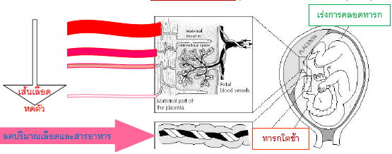
Stress effect on pregnancy

Slide 24
Social support as a moderator of life stress.
Social support can protect people in crisis from a wide variety of pathological states: from low birth weight to death,...
Furthermore, social support may reduce the amount of medication required, accelerate recovery, and facilitate compliance with prescribed medical regimens.
Cobb S. Psychosom Med 1976; 38: 300–14.

Slide 25
Birth. 2000 Jun;27(2):97-101.
Webster J, Linnane JW, Dibley LM, Hinson JK, Starrenburg SE, Roberts JA
Measures of support included support from family, support from the baby’s father, and general functional support.
Prenatal social support is associated with infant birth weight through processes involving fetal growth rather than those involving timing of delivery.

Slide 26
Conclusion:
The family involvement in ANC process correlated favorably with lowering percentage of LBW.
Anemia at first ANC correlated to high percentage of LBW.
But anemia only after 32 gestational week did not correlate with LBW.
The family involvement and anemia during ANC need the further study of their both management impact on LBW outcome.

Slide 27
สายใยรักแห่งครอบครัว Family Bonding protects Pregnancy

Slide 28
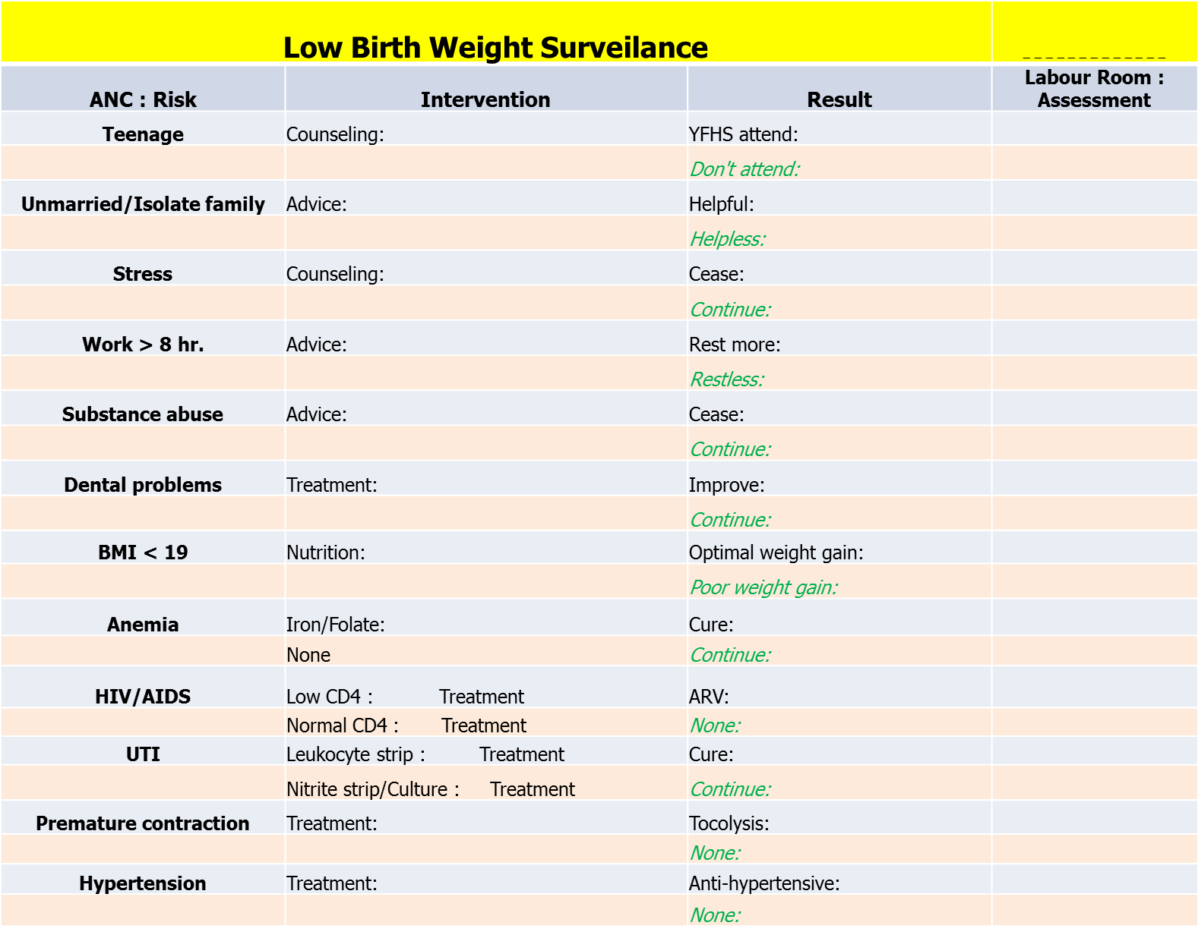

Slide 29
Risk & Intervention Outcome & LBW
What is successful intervention
Impact on LBW
สายใยรักแห่งครอบครัว
Family Bonding protects Pregnancy

